Slide 1
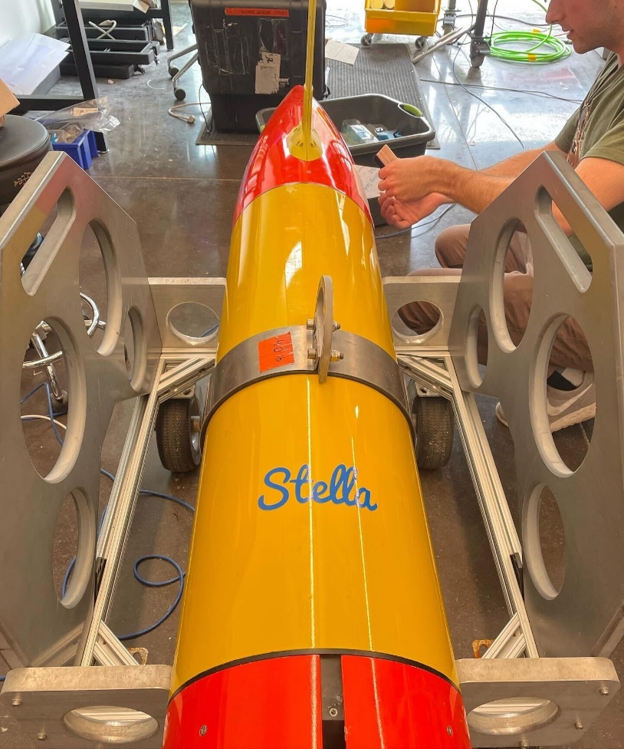
ADAC Year 8 Annual Meeting
April 2022
ADAC Project Briefing
(LRAUV) for Under-Ice Mapping of Oil Spills and Environmental Hazards
PI Amy Kukulya (WHOI)
PI Brett Hobson (MBARI)
and Noa Yoder (WHOI, presenter)

Slide 2
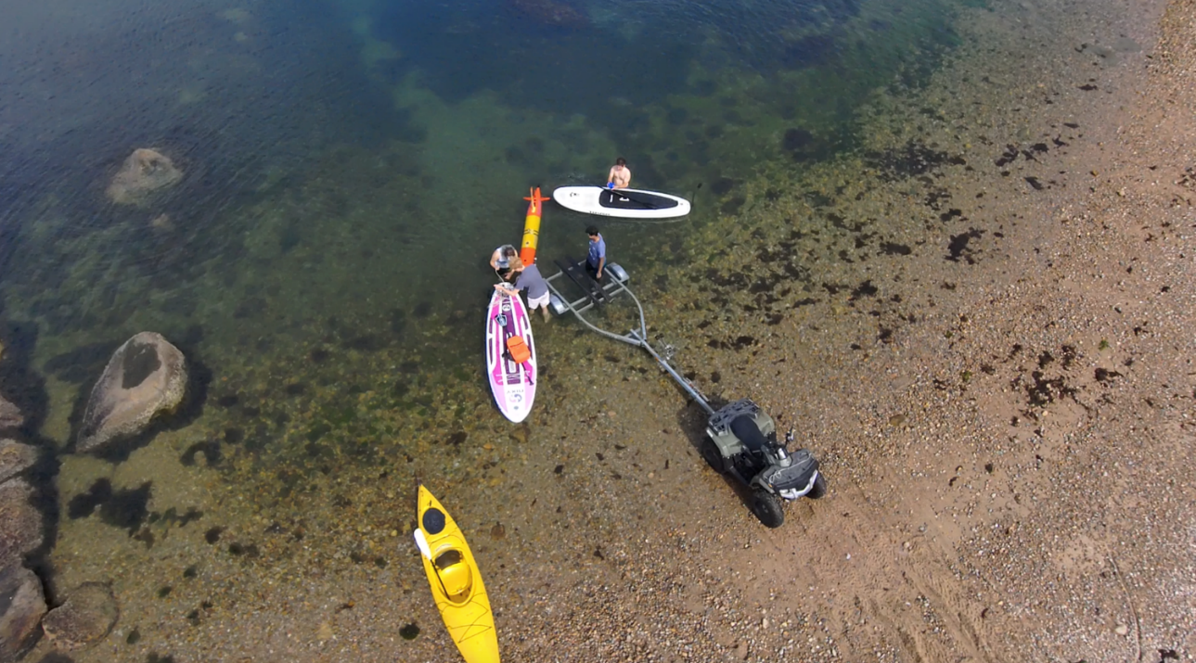
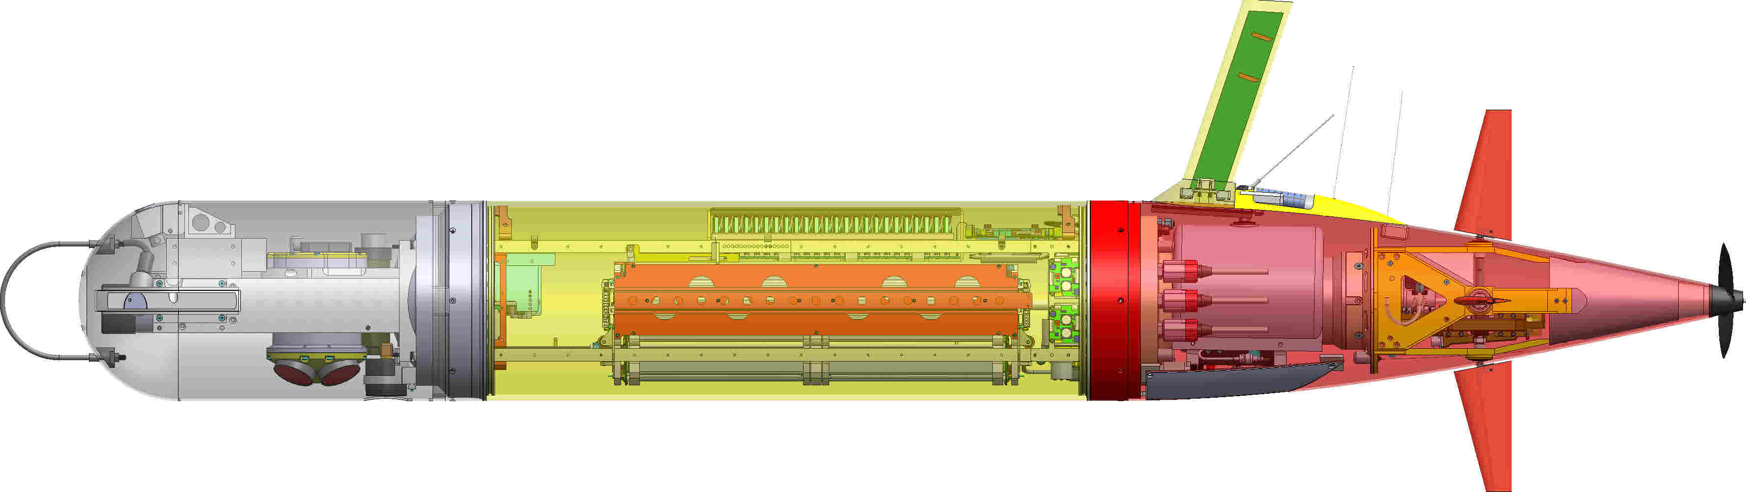
ADAC Project (LRAUV) for Under-Ice Mapping of Oil Spills and Environmental Hazards
Project Principal Investigator(s): PI/PM Amy Kukulya (WHOI), Co-PI Brett Hobson (MBARI)
Woods Hole Oceanographic Institution, Monterey Bay Aquarium Research Institute
Supporting Team: Daniel Gomez-Ibanez, Noa Yoder, Amanda Besaw, Brian Kieft, Ben Raanan, Ryan Govostes, Steven Seeberger, Kaitlyn Tradd, Adarsh Salagame, Aidan Kenny, Cameron Fairclough
Project Champion: Kirsten Trego, HQ USCG MER
Project Advocates: Dr. Robyn Conmy, EPA USEPA/NRMRL/RTEB, USCG Research and Development Center, Dr. Jay Choy BSEE/Oil Spill Preparedness Division, Dr. Lisa Dipinto, NOAA, Office of Restoration and Response, Mr. Brian Dolph, USCG R&D Center

Slide 3
LRAUV: Description and Baseline
Baseline: Currently, there is no USCG baseline for an AUV to meet the unique demands of Arctic operations that requires a minimal logistical footprint, a small operational team and oil detection and mapping capability.
Project Description: To develop an Arctic-capable long-range Autonomous Underwater Vehicle (AUV) that is helicopter portable, carries an environmental mapping payload, allowing rapid response while providing situational awareness and damage mitigation for first responders/USCG.

Slide 4
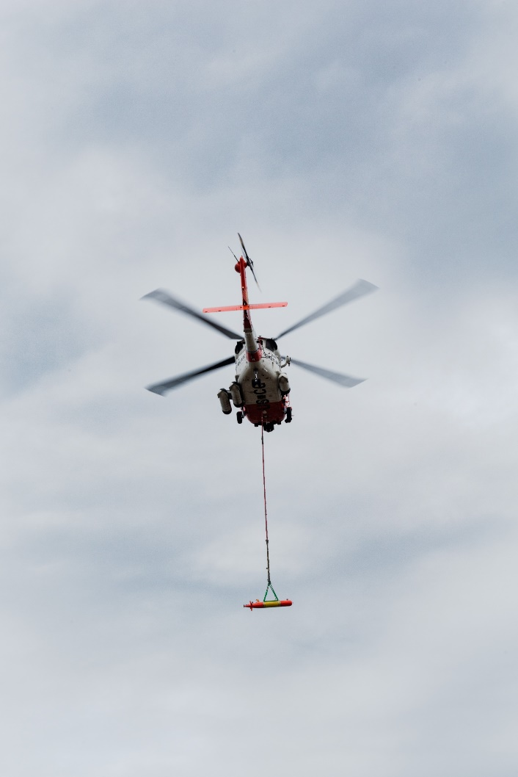
Project LRAUV Relevance and Method
Relevance to DHS and USCG: We characterize the challenge as the ‘last seat in the helicopter’ problem: If first responders are operating at the far end of their logistical support capability, the system must be able to fill that void.
Research Method: Our approach leveraged an existing base Long-Range AUV developed at MBARI (LRAUV), and enhance the system to detect oil and operate under ice. LRAUV offers extended ranges (one to three weeks), and can be operated by a team remotely and monitored by anyone, anywhere.
  Next up:
    Prior (where you have been)
    Current (where you are at)
    Projected (where you want to go)

Slide 5
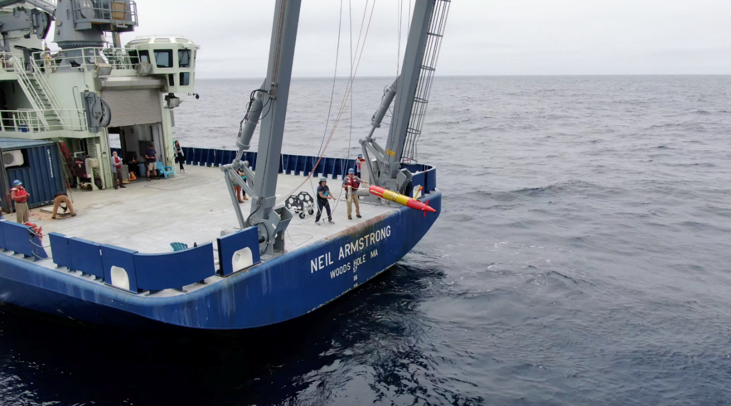
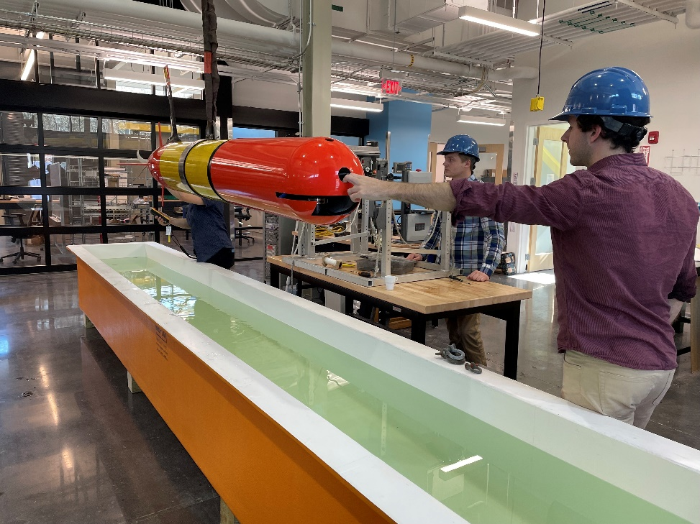
ADAC LRAUV Updates
Backseat- wireless joystick driving (Co-op project)
  Now works over cell for longer range
  Backseat- Sidecar Action Manager development, allowing sensors and behaviors to be developed in a vehicle agnostic way so capabilities can be leveraged across platforms (students, software engineers)
LRAUV backseat computer system health monitor ROS node
LRAUV Software Simulation
  Hardware in the loop to test things like oil spill simulations
  Currently set up with Burger Oil field Simulation
  Lab tests are successful and now needs open water testing for Arctic demo preparation

Slide 6
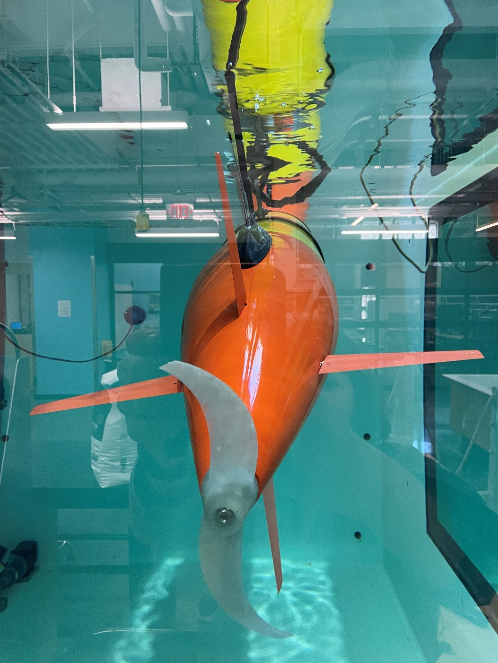
LRAUV Updates:
  Ran 3 over-the–horizon missions.
  Completed 450 km mission offshore (shipless) X 2
  Conducted two virtual Stakeholder training sessions
  Developed new software behavior missions (>20) for docking, undocking, no surfacing, new sensor configurations
  Provisional Patent

Slide 7
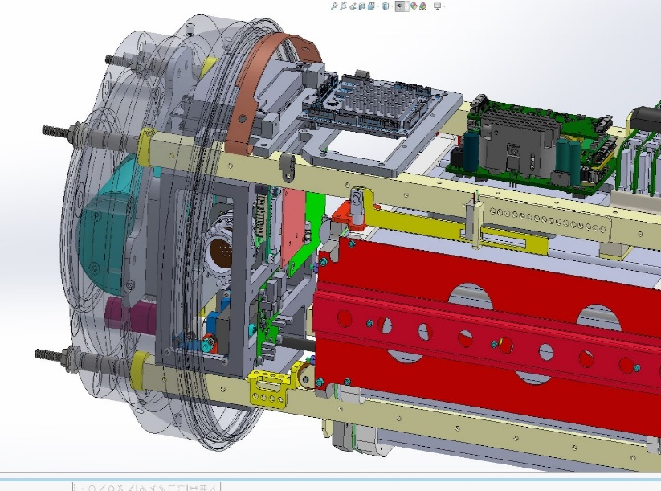
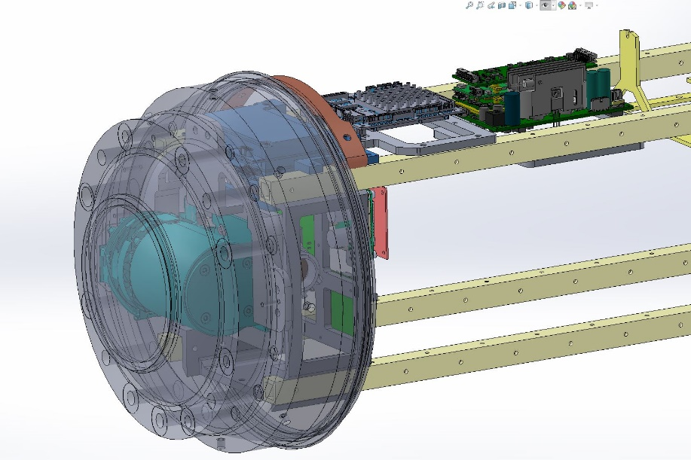
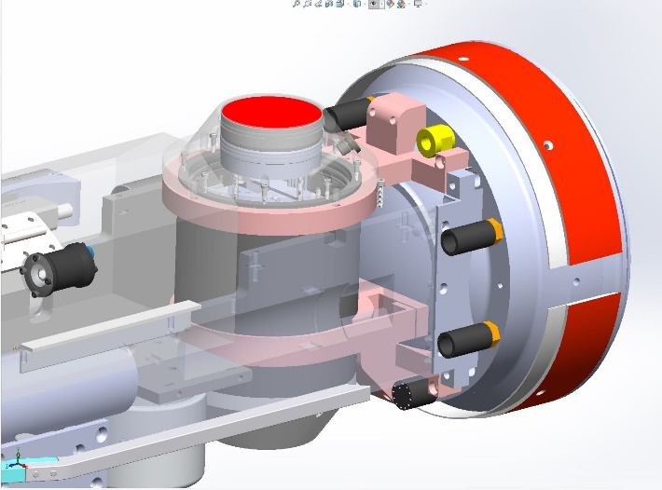
Where we are at:
  Developed LBL (filter updates implemented)
  Integrated multibeam on Stella
  Completed Stella Build!
  Refined docking (extreme cold tolerant gearbox installed and tested successfully)
  Developed onboard sim mission for plume tracking tests
  Updated plume tracking algorithm (MBARI testing)
    Burger Oil field Sim tested on vehicle in lab
  Built second docking nose (for Stella)
  Working on software for GPS, time, timing (1 PPS), for IMU and sonar, new PIC board- Completed and bench testing
  All updated wiring for new sensors and config complete
  Built vehicle in a box, Proxima (for rapid testing)

Slide 8
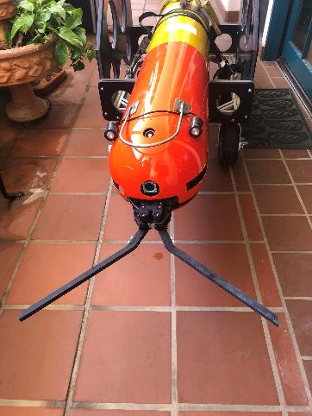
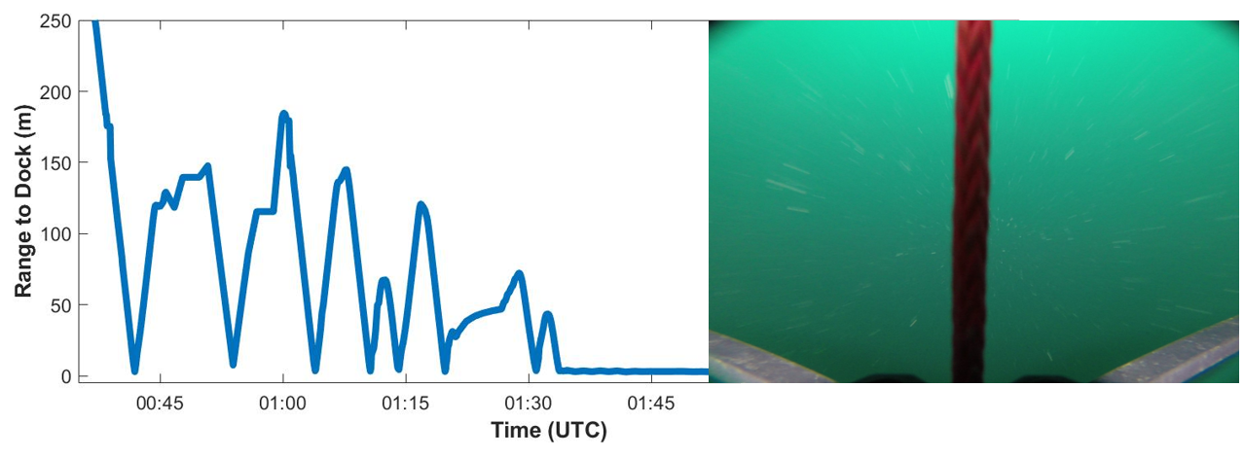
Polaris Applications
DOCKING Payload Completed
Polaris homes to the Acoustic Gateway Buoy using a USBL. Then it uses the Dynamic Docking Module (pictured left) to hook and latch onto the buoy anchorline. This conserves energy while awaiting new missions or recovery.

Slide 9
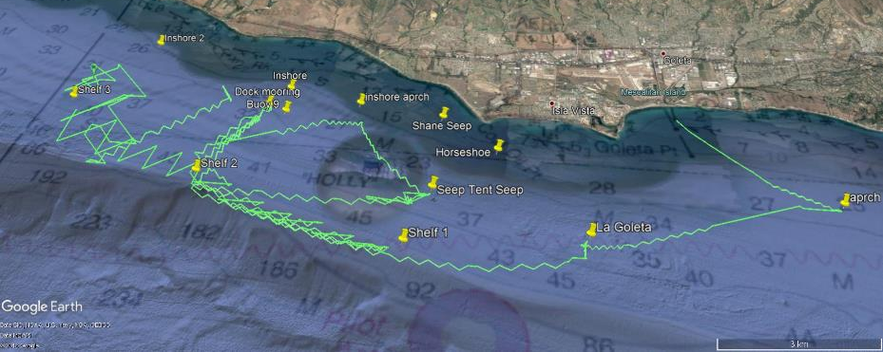
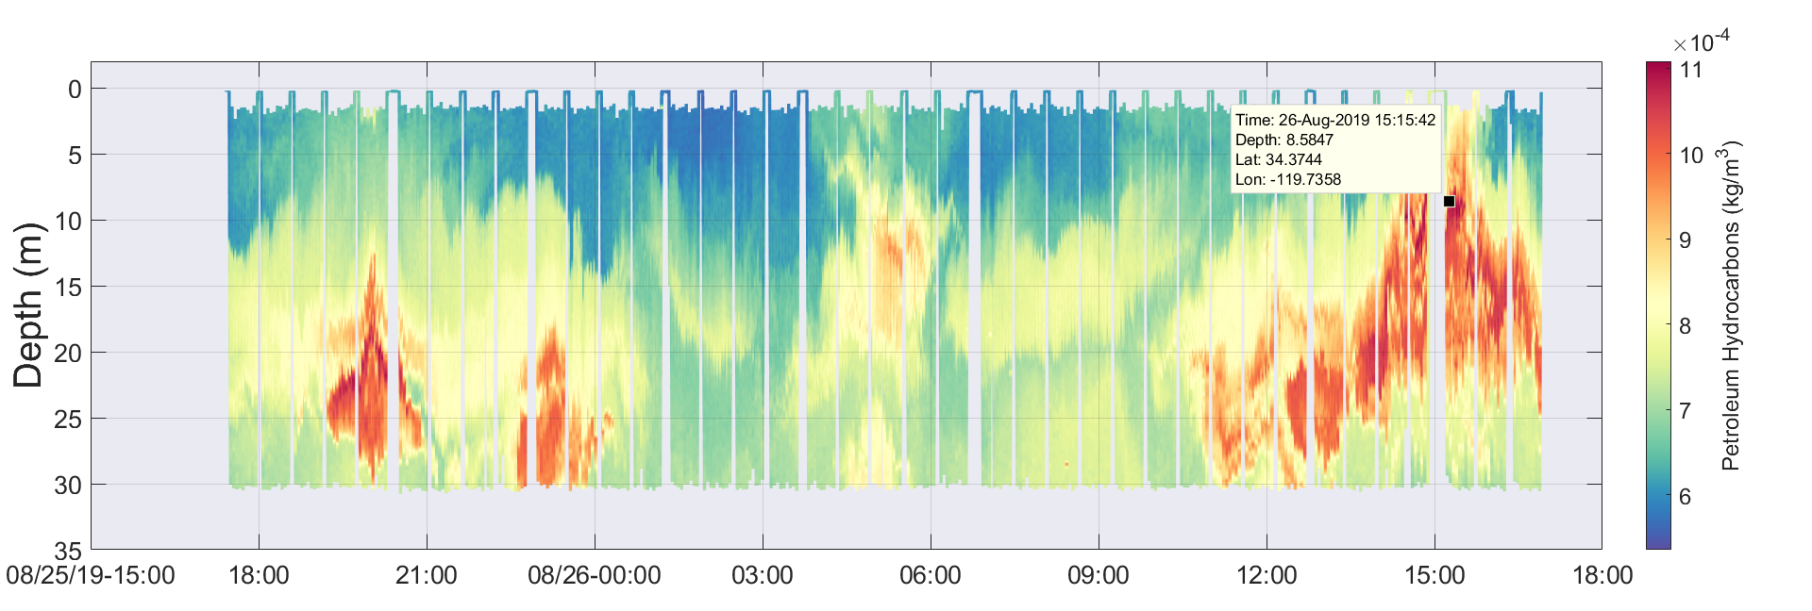
Polaris Applications
Oil Spill Mapping
Polaris uses the SeaOwl UV-A sensor to detect dissolved petroleum hydrocarbons in the water using optical backscatter.

Slide 10
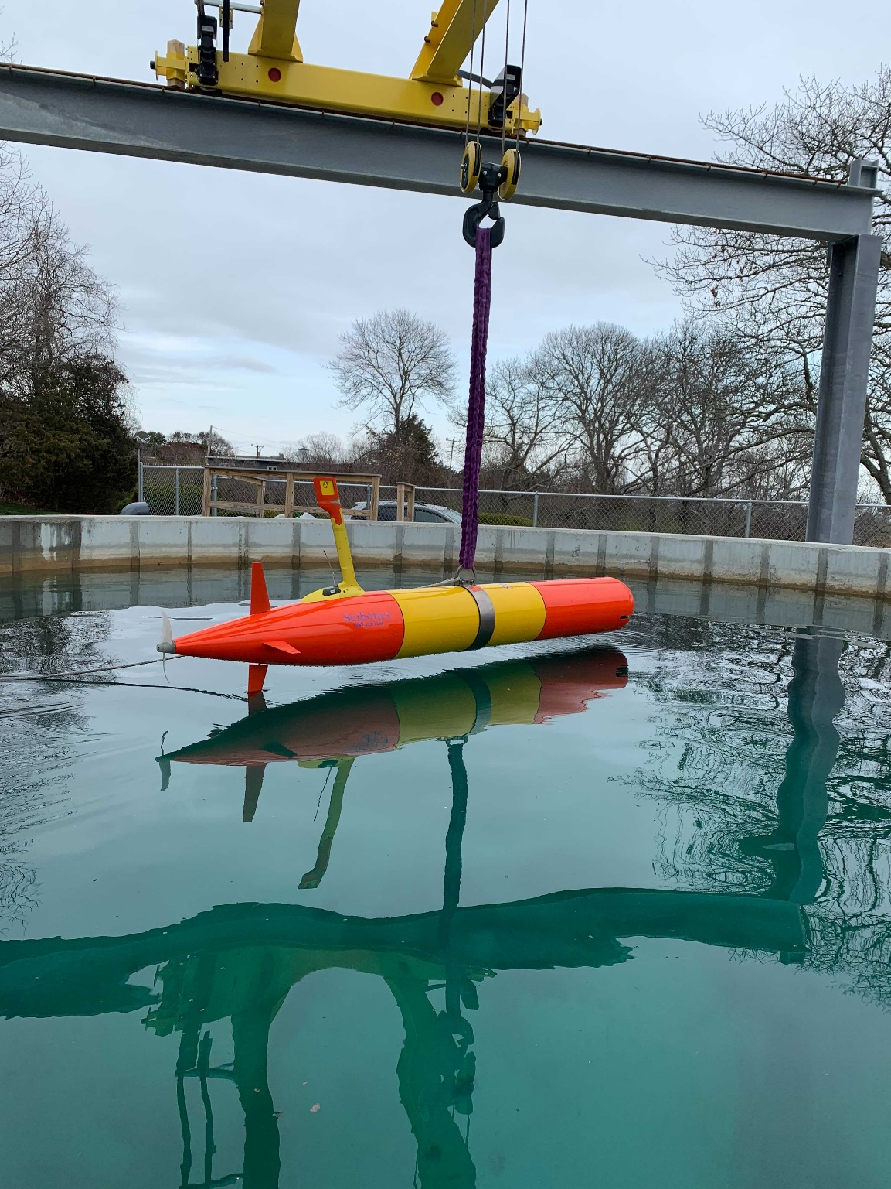
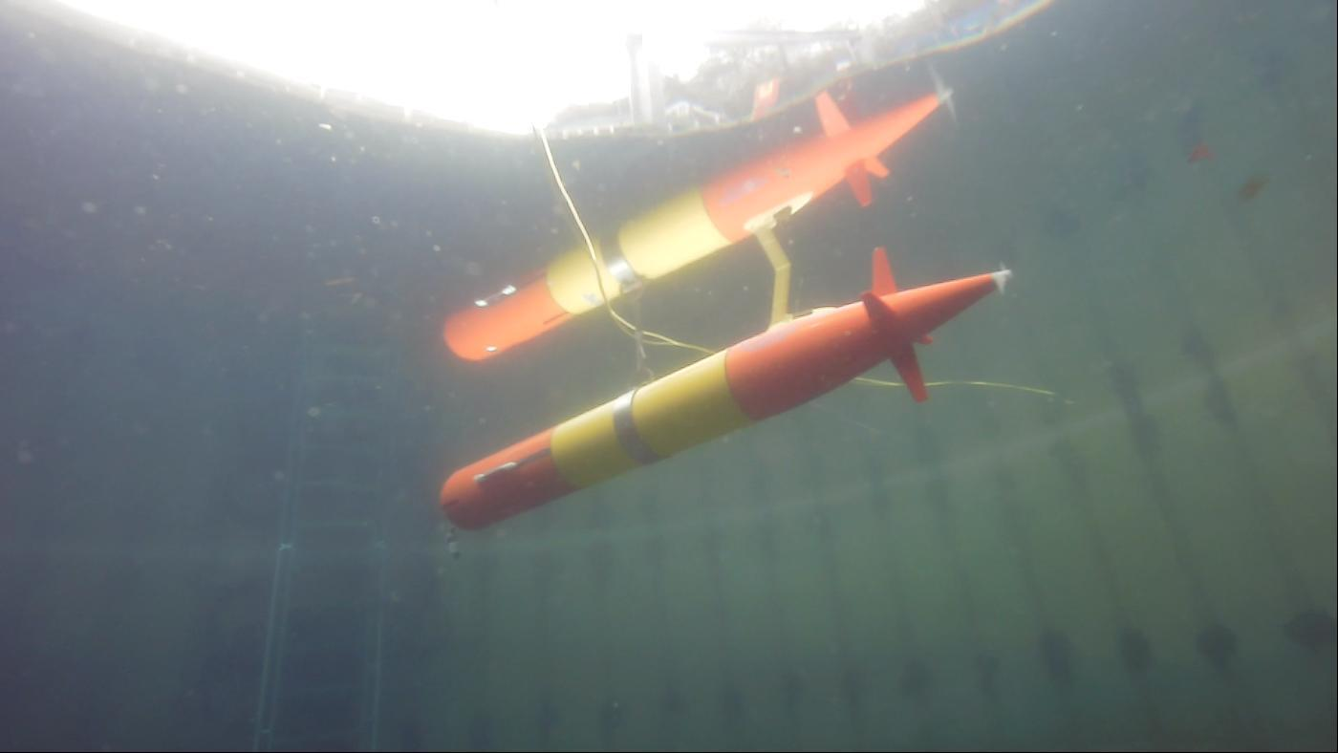
Introducing STELLA!

Slide 11
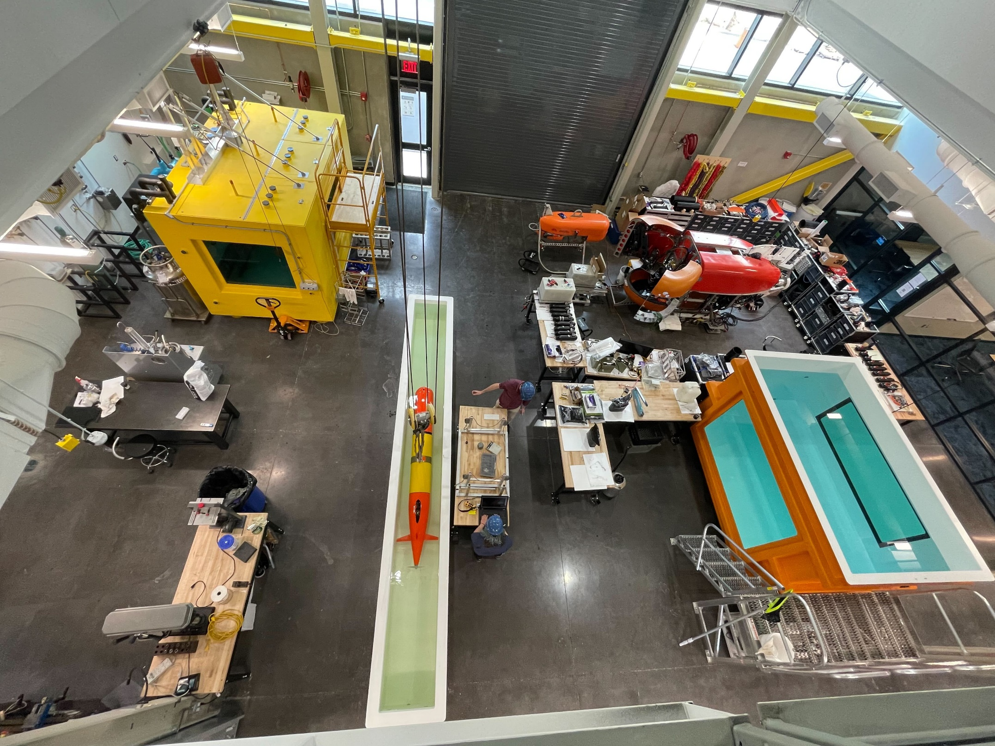
The WHOI Scibotics Team leveraged WHOI’s Innovation Center to build, integrate and test sensors and Stella with lots of MBARI synergistic collaboration

Slide 12
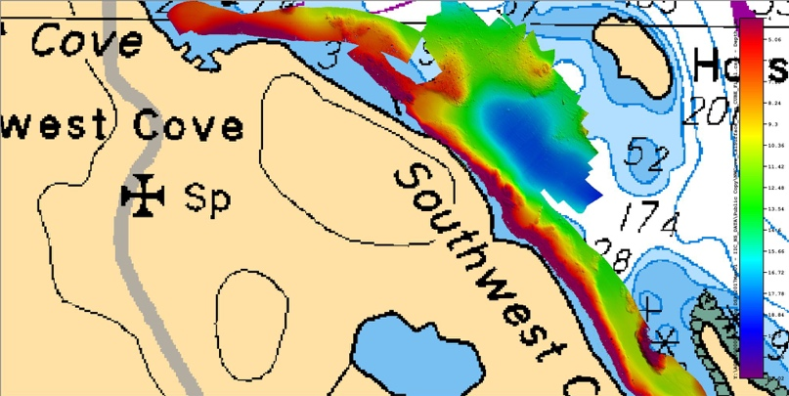
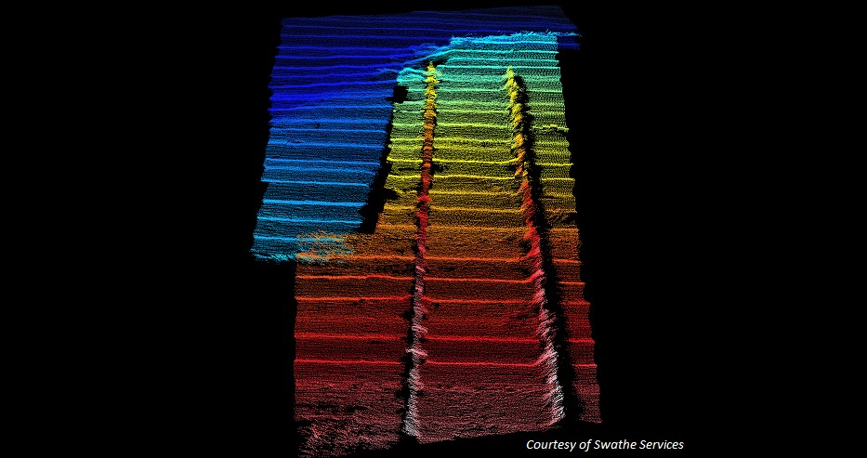
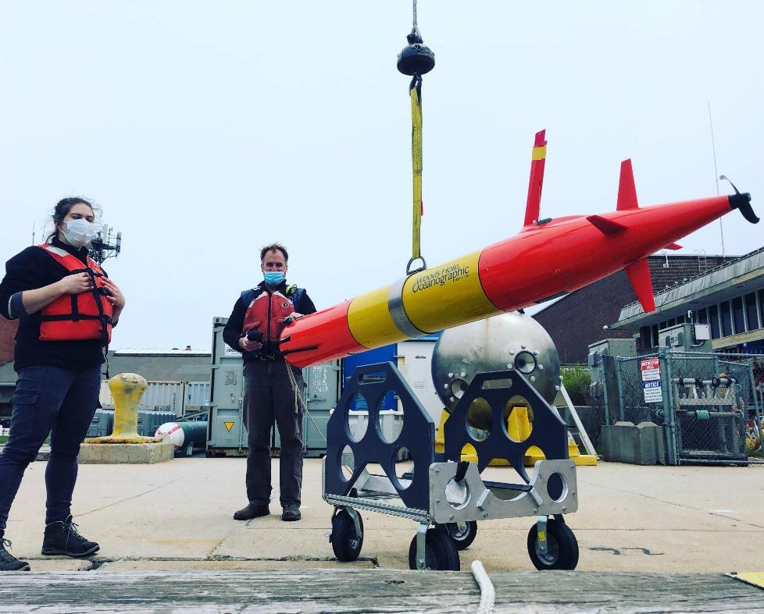
Polaris & Stella have interchangeability
Multi-mission capability
Seafloor mapping
Bathy charts
Shipwreck search/map
Under-ice and glacier mapping
Under-ice and in water oil/gas detection
Notes:
Adding payloads and multi-mission capability
Norbit 400kHz (Frequency Agility 200-700kHz) WBMS Bathymetric System
integrated with Real-time Sonar Head Sound Velocity Sensor. Includes
Snippets, Sidescan, Backscatter and Water Column Output. Includes Sonar
Interface Unit (SIU-I)

Slide 13
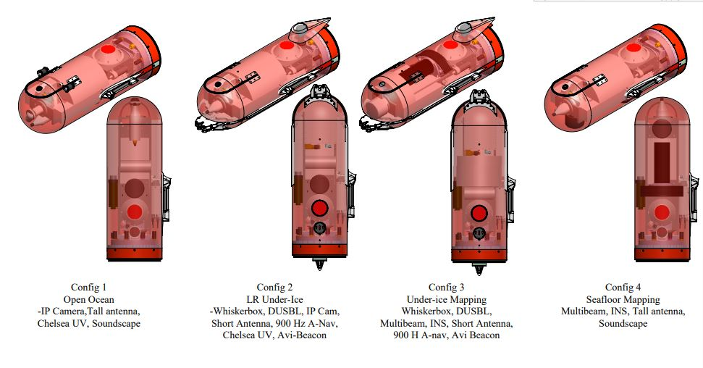
Where we are going:
  Two LRAUV vehicles with four nose configurations:
    Open water science standard sensors, tall antenna, Chelsea UV, Soundscape
    LR under-ice with Whiskerbox, DUSBL, short antenna, Chelsea UV, Avi-beacon with room for camera, 900 Hz A-Nav
    Under-ice mapping, Whiskerbox, DUSBL, Multibeam, INS, short antenna, 900 Hz A-Nav, Avi Beacon
    Seafloor mapping, Multibeam, INS, tall antenna, soundscape

Slide 14
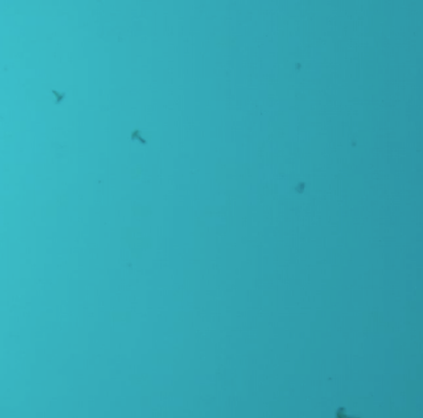
ADAC LRAUV Updates
Leveraged funding from NSF project to develop and test 2D front tracking algorithm
Choose your Proxy
Illustration of the AUV’s horizontal zigzag tracks alternating in westward and eastward sweeps between a western bound and an eastern bound. Over the duration of the sweeps, the front moved southward. On every instance of front detection, the vehicle continues flight for a prescribed distance (marked green), and then turns an oblique angle to fly back to the other water column. When the AUV reaches the western bound, it reverses course.
In one mission on 25 June 2021, LRAUV Polaris detected and passed through the salinity-intrusion front five times. Front detection on each transect is shown in Fig. 8, with corresponding transect numbers.
Snapshot from LRAUV camera capturing squid in a salt intrusion
(Figures courtesy of Yanwu Zhang, MBARI and not for distribution)

Slide 15
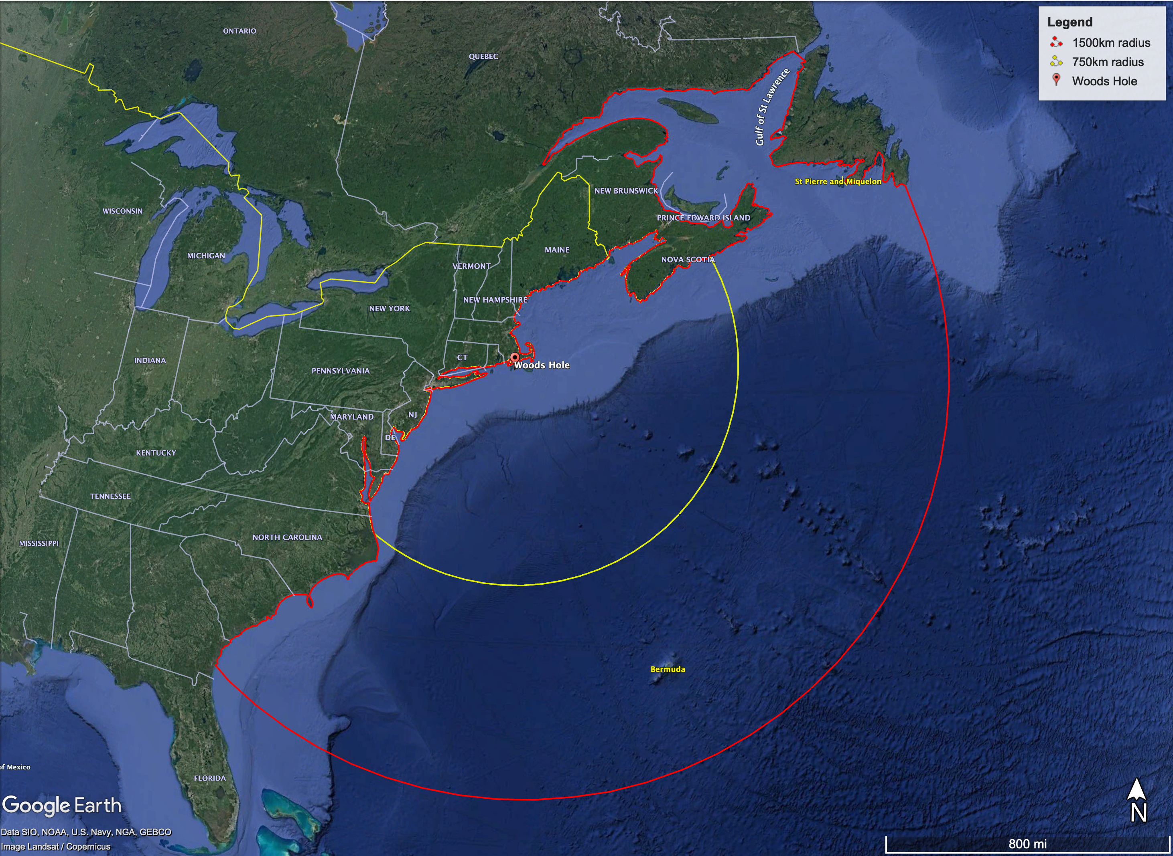
What you can expect:
Bermuda, anyone?

Slide 16
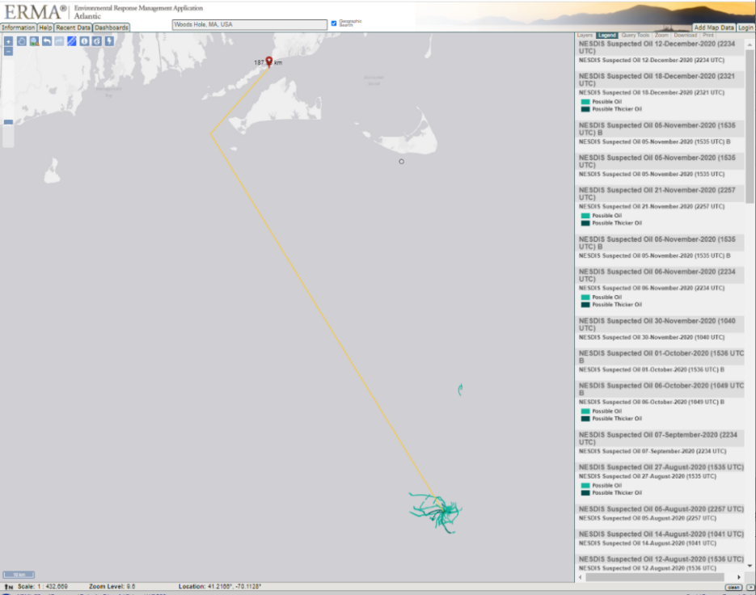
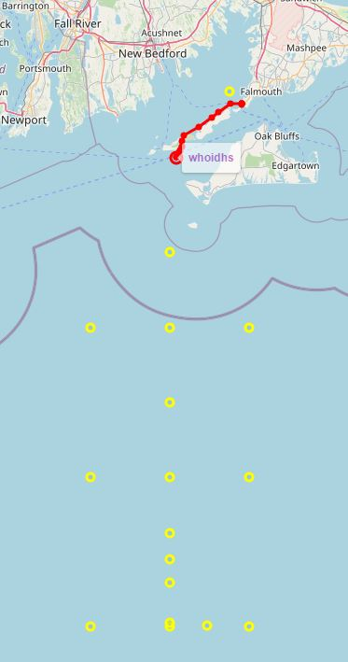
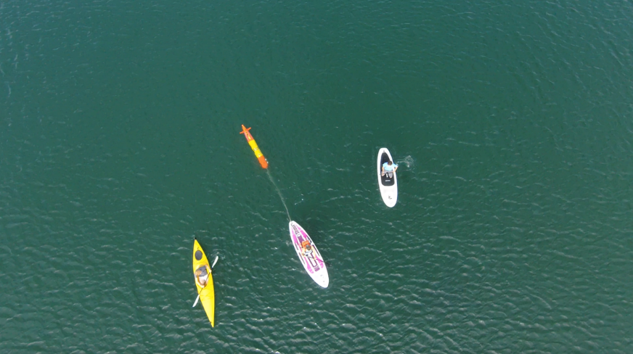
Long-range adds versatility: Wreck 1487
Overview of over-the-horizon mission – Shipless Operations
188 km from Woods Hole shipwreck actively leaking oil….in LRAUV wheelhouse (Scott Lungren (NOAA)

Slide 17
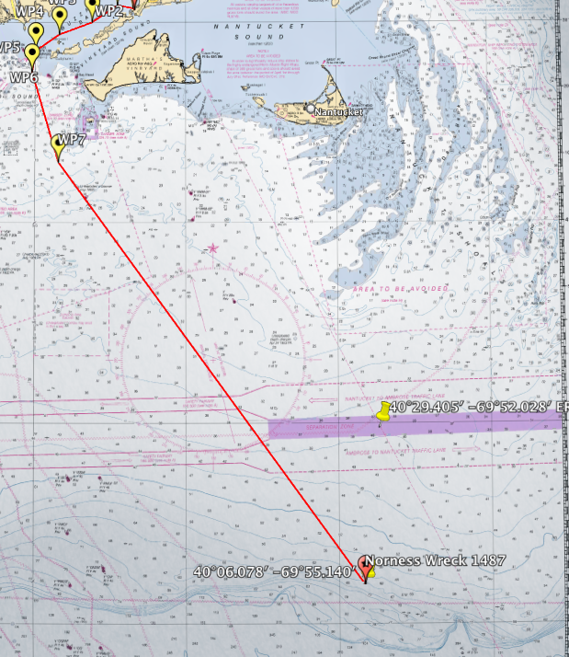
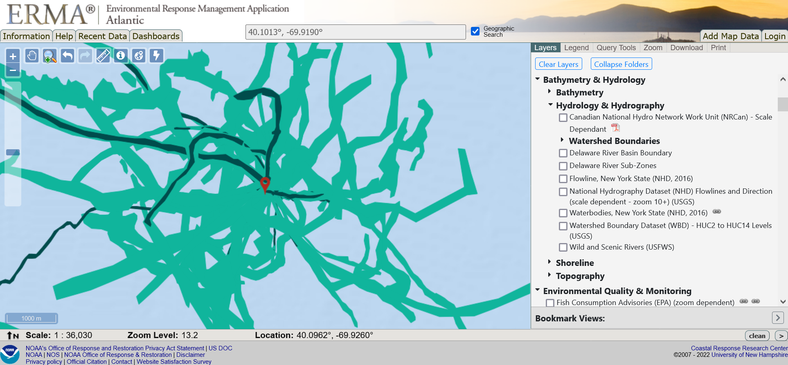
Long-range adds versatility: Wreck 1487
13 day mission out to the shelf break and back with LRAUV
Started out as a find-the-oil mission
A Nor’ester hit the area and we reprogrammed to yo-yo to collect storm impact data on T&S
Notes:
There are 7-8 other wrecks in the area they would love to be surveyed. 11 leaky wrecks in the NE (although the number is growing and now should include the ANDREA DORIA
Sometimes USCG training divers dive on these wrecks but priority is set based on Hurricane Ida impacts currently and unlikely NE wrecks will be practice dives.
On May 20th, 2013, NOAA presented the U.S. Coast Guard a national report that finds 36 sunken vessels scattered across the U.S. seafloor could pose an oil pollution threat to the nation's coastal and marine resources. Of those, 17 were recommended for further assessment and potential removal of both fuel oil and oil cargo.
EEZ wrecks

Slide 18
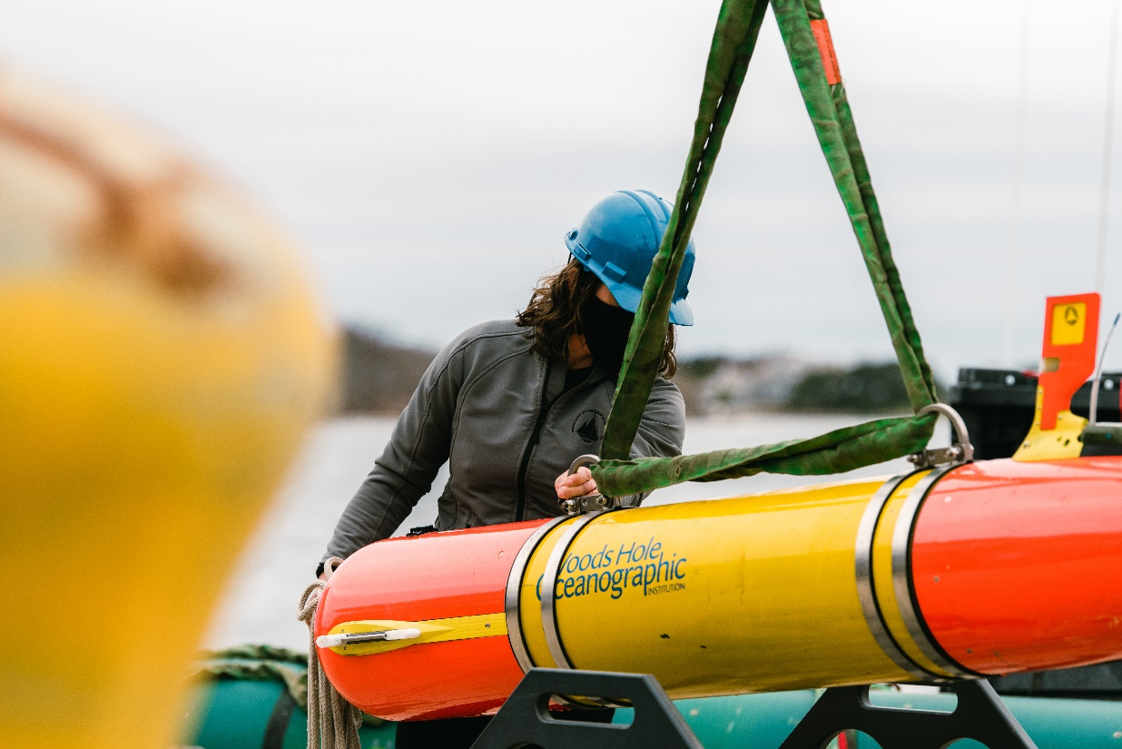
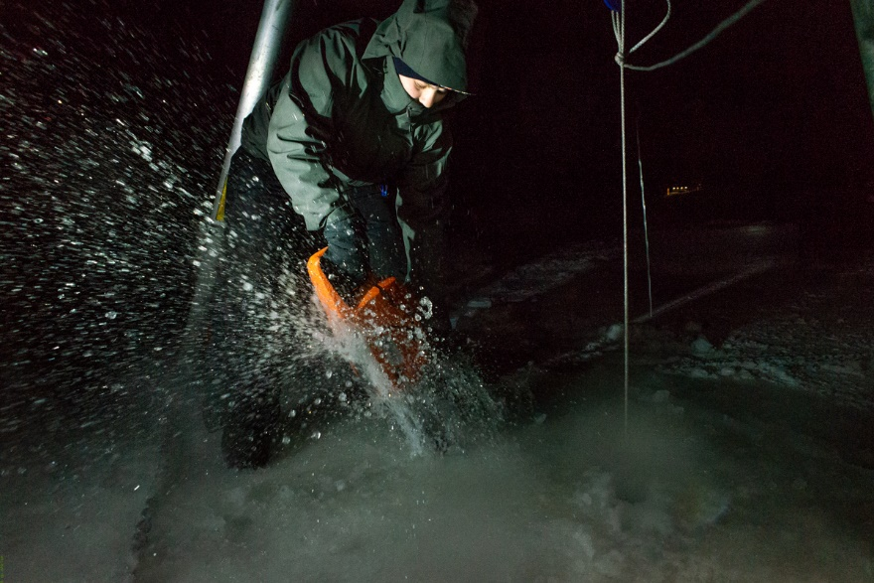
Where we are going: Growing Applications!
  Fly away capability with rapid response for oil spills, sunken ships (etc.), pipe leaks, seafloor mapping, habitat monitoring, measuring soundscapes (weather, whales, etc.), long-range shipless surveys, open ocean, fresh water and under-ice capabilities over-the-horizon data relay, 24/7 operator response
  Center of Expertise
  Go to for help…it’s already happening…USCG, NTSB, NOAA, USGS, Science community…

Slide 19
Project LRAUV: Schedule and Metrics
Fabrication of a second platform (Stella) Conducted Arctic Readiness Testing, over-the-horizon testing, docking and acoustics
  Three buoy system completed- one buoy is HF, two LF
  Docking/Undocking reliability ~60% and a new cold weather gear box has been switched out
  Comms reliability (antenna/buoy/Dash)
Provide training and familiarization of LRAUV to USCG
Develop software for improved operator system interface
  Backseat is integrated, new sensors can be integrated.
  Multibeam is integrated
  Inertial navigation is integrated
  Dash operator Portal is complete at LRAUV.WHOI.EDU and receives monthly updates/improvements

Slide 20
Project LRAUV: Planned Research Outcomes
Planned outcomes of the research:
  A helicopter portable Long Range AUV, for under-ice and over-the-horizon shipless anomaly and oil detection with deployable Arctic buoys for aided navigation, remote communication and docking; around-the-clock expertise available and training with a TRL 6/7 system ready for low-rate manufacturing and payload capability expansion.
Additional research identification:
  Service for hire
  Interest in commercialization
  Interest in scientific community to use and develop tech (BSEE, EPA, NOAA, etc.)
    (more vehicles, deeper ratings, recharge capabilities)

Slide 21
What needs improvement or is missing?
  Sensing of oil against the ice and seafloor and high latitude testing
  More sensor payloads-Echosounders, Cameras, Water sampling, energy harvesting
  More operational time for shake-down and training
  Software development (behaviors) and backseat autonomy
  System upkeep funding
  LARS for helicopter---have ideas
  How can we be ready and respond to current events?
Who should we connect with to improve odds of success?
  Engage with USCG operators early and frequently
  Broaden R&D support
  Be a part of oil spill technology and response meetings
  Need to coordinate field operations with first responders and fill technology gaps that are identified
  Continue to connect with alternative funding sources like ONR, NOAA and BSEE to help fund operations and sensor development (methane, what else?)
  Need more vehicles
Input on future from you: Do we need 2, 5, 10 vehicles?

Slide 22
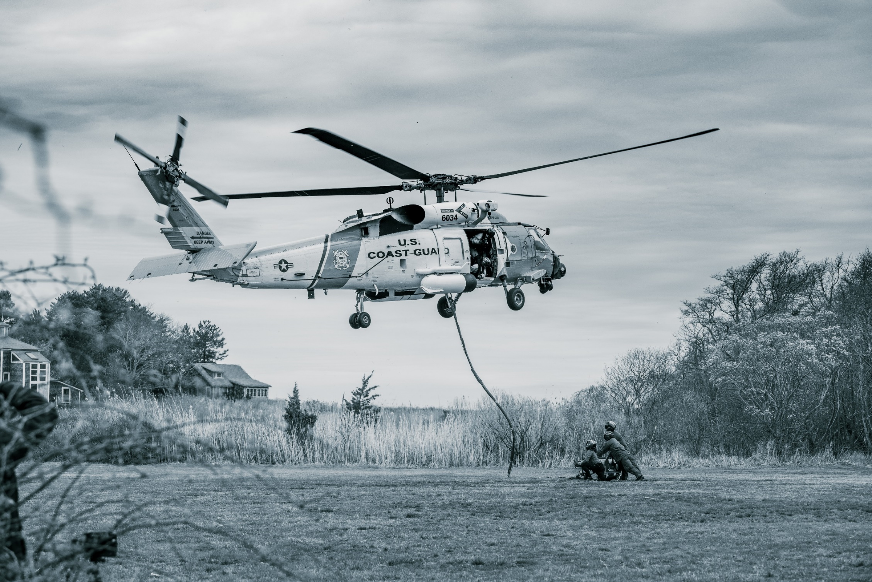
Transition…
Persistent observations on the order of weeks and spanning 10s–100s of km
Relevant observations require comprehensive sensing capabilities and investment

Slide 23
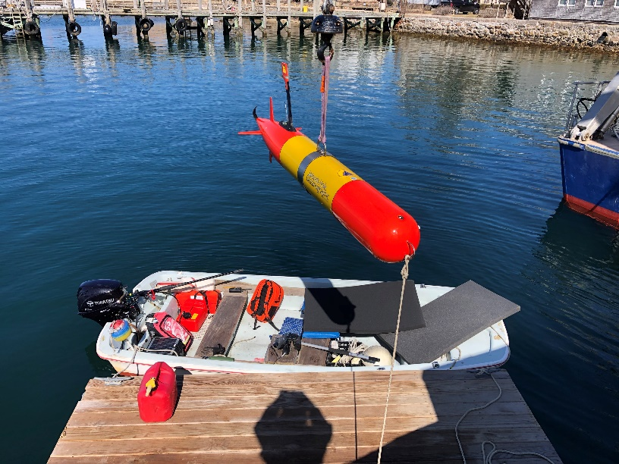
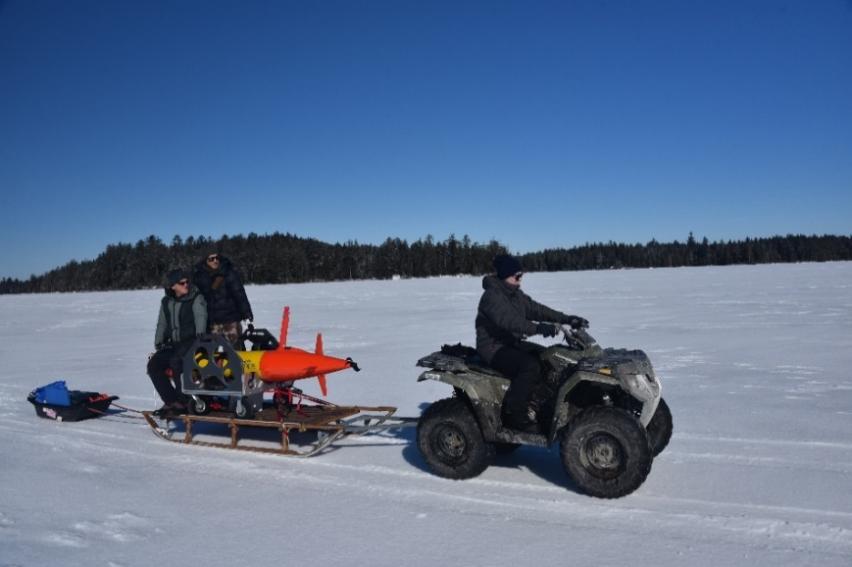
Project LRAUV: Transition Plans
Two-Stage Transition Plan:
  Build one or more systems to support USCG complete with successful open-water and under-ice demonstrations. WHOI trains USCG operators with support funding. WHOI can support USCG on site or remotely via iridium vehicle communications as needed. 24 hr support possible.
  Commercialize resulting platform: Based on lessons learned from (1), prepare the system for commercialization by accessing WHOI CMR fabrication resources. LRAUV was not designed for efficiency of manufacturing and rapid prototyping, therefore revisiting AUV design is a top priority.

Slide 24
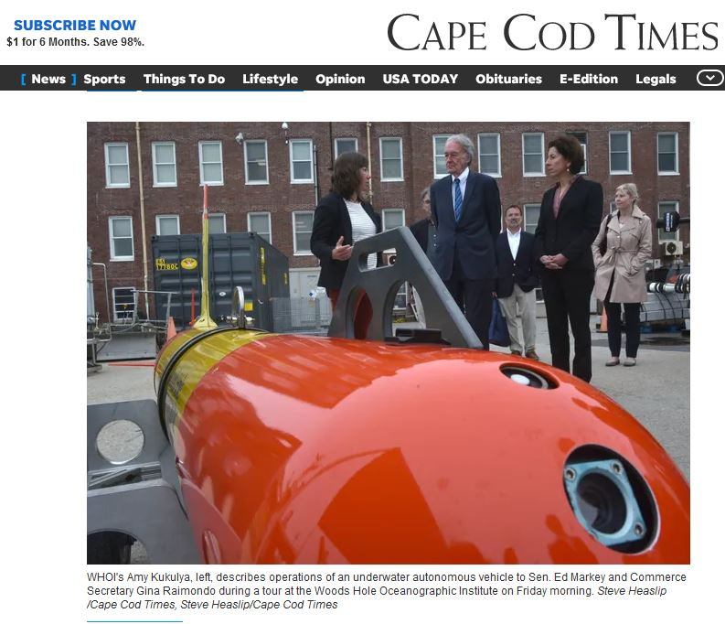
Project LRAUV: Transition Plans
Pathway to Transition:
Create an operational system that the USCG can use for characterizing spills in ice-covered ocean environments. Transition advantages of the LRAUV platform:
  Contains commercially available sensors
  Can be replicated for the USCG
  Has a proven vehicle design and proven reliability
  Sensor commonality

Slide 25
Project LRAUV: Transition Plans
Transition Plan includes the following:
  Facilities: WHOI operates facilities for fabrication, testing, logistics (on-ice support) and platforms such as ALVIN
  Service for-Hire: Operators and AUV’s such as the REMUS are available for hire and also have been transitioned into both the Navy and commercial sectors
  Hardware Builds: WHOI has a history of replicating systems and training end users
  Commercialization: Demand for WHOI built systems may occur through spin-off companies or through licensing the technology to a commercial entity. (example: Hydroid Kongsberg with REMUS and Bluefin from MIT, Bellingham)

Slide 26
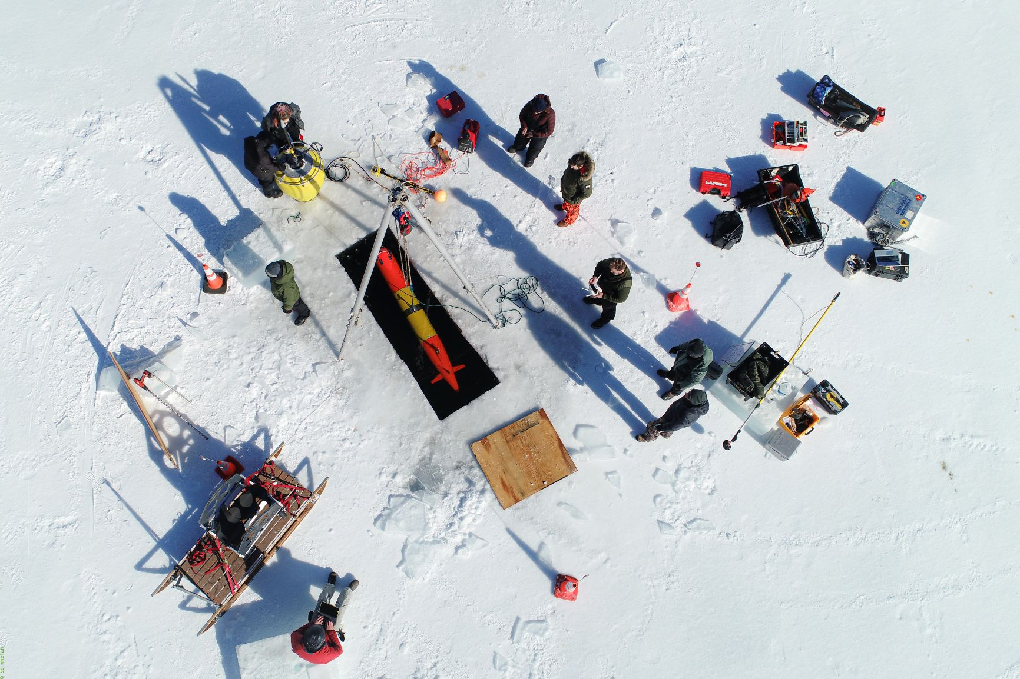

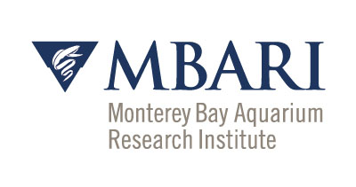
Thanks and
LRAUV Ready for questions

